Slide 1
“THEORY OF AUTOMATA”
Distinguishable strings and Indistinguishable strings

Slide 2
Summary
Intersection of two regular languages, examples, non regular language, example

Slide 3


Example
Consider two regular languages L₁ and L₂, defined over the alphabet ∑= {a, b}, where L₁ = language of words with double a’s. L₂ = language of words containing even number of a’s. FAs accepting languages L₁ and L₂ may be as follows

Slide 4
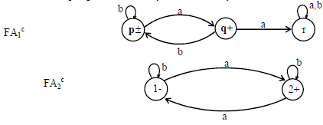
Their corresponding REs may be
r₁ = (a+b)*aa(a+b)*
r₂ = (b+ab*a)*
Now FAs accepting L₁^{c} and L₂^{c} , by definition, may be

Slide 5
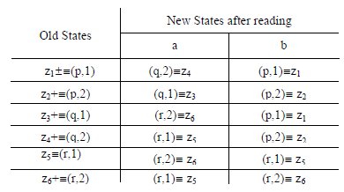
Now FA accepting L₁^{c} U L₂^{c} , using the method described earlier, may be as follows

Slide 6

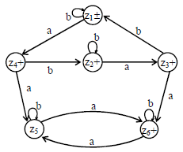
Here all the possible combinations of states of FA₁^{c} and FA₂^{c} are considered

Slide 7
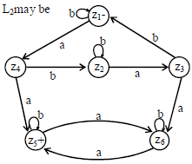
An FA that accepts the language (L₁^{c} U L₂^{c})^{c} =
L₁ U

Slide 8
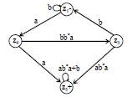
Theorem
Corresponding RE can be determined as follows.
The regular expression defining the language L1 n L2 can be obtained, converting and reducing the previous FA into a GTG as after eliminating states z₂ and z₆

Slide 9
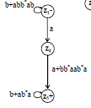
after eliminating state z₃

Slide 10

z4 can obviously beeliminated as follows
eliminating the loops at z₁ and z₅
Thus the required RE may be (b+abb*ab)*a(a+bb*aab*a)(b+ab*a)*

Slide 11
FA corresponding to intersection of two regular languages (short method) Let FA₃ be an FA accepting L₁ U L₂, then the initial state of FA₃ must correspond to the initial state of FA₁ and the initial state of FA₂.
Since the language corresponding to L₁ U L₂ is the intersection of corresponding languages L₁ and L₂, consists of the strings belonging to both L₁and L₂, therefore a final state of FA₃ must correspond to a final state of FA₁ and FA₂. Following is an example regarding short method of finding an FA corresponding to the intersection of two regular languages.

Slide 12


Example
Let r₁ = (a+b)*aa(a+b)* and FA₁ be
also r₂ = (b+ab*a)* and FA₂ be

Slide 13
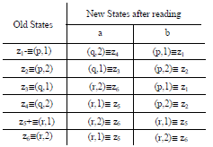
U
An FA corresponding to L₁ L₂ can be determined as follows

Slide 14
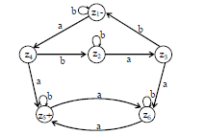
The corresponding transition diagram may be as follows

Slide 15
Nonregular languages
The language that cannot be expressed by any regular expression is called a Nonregular language.
The languages PALINDROME and PRIME are the examples of nonregular languages.
Example
Consider the language L = {K, ab, aabb, aaabbb, …} i.e. {a^{n} b^{n} : n=0,1,2,3,…}
Suppose, it is required to prove that this language is nonregular. Let, contrary, L be a regular language then by Kleene’s theorem it must be accepted by an FA, say, F. Since every FA has finite number of states then the language L (being infinite) accepted by F must have words of length more than the number of states. Which shows that, F must contain a circuit.

Slide 16
Example of nonregular language, pumping lemma version I, proof, examples.
Example
Consider the language L = {K, ab, aabb, aaabbb, …} i.e. {a^{n} b^{n} : n=0,1,2,3,…}
Suppose, it is required to prove that this language is nonregular. Let, contrary, L be a regular language then by Kleene’s theorem it must be accepted by an FA, say, F. Since every FA has finite number of states then the language L (being infinite) accepted by F must have words of length more than the number of states. Which shows that, F must contain a circuit.

Slide 17
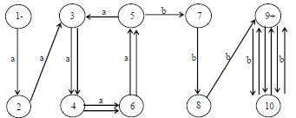
For the sake of convenience suppose that F has 10 states. Consider the word a⁹ b⁹ from the language L and let the path traced by this word be shown as under
But, looping the circuit generated by the states 3,4,6,5,3 with a-edges once more, F also accepts the word a⁹⁺⁴ b⁹, while a¹³b⁹ is not a word in L. It may also be observed that, because of the circuit discussed above, F also accepts the words a⁹(a⁴ )^{m} b⁹, m = 1,2,3, …

Slide 18
Moreover, there is another circuit generated by the states 9,10,9. Including the possibility of looping this circuit, F accepts the words a⁹(a⁴ )^{m} b⁹(b² )^{n} where m,n=0,1,2,3,…(m and n not being 0 simultaneously). Which shows that F accepts words that are not belonging to L.
Similarly for finding FAs accepting other words from L, they will also accept the words which do not belong to L.
Thus there is no FA which accepts the language L. which shows, by Kleene’s theorem, that the language L can’t be expressed by any regular expression.

Slide 19
Pumping Lemma
Statement
Let L be any infinite regular language (that has infinite many words), defined over an alphabet A then there exist three strings x, y and z belonging to A* (where y is not the null string) such that all the strings of the form xynz for n=1,2,3, … are the words in L.

Slide 20
Proof
If L is a regular language, then according to Kleene’s theorem, there exists an FA, say, F that accepts this language.
Now F, by definition, must have finite no of states while the language has infinitely many words, which shows that there is no restriction on the length of words in L, because if there were such restriction then the language would have finite many words.
Let w be a word in the language L, so that the length of word is greater than the number of states in F.
The word w, in this case, may be divided into three parts
Thus the word may be written as w = xyz where x,y and z are the strings, also y can’t be a null string.
Now this is obvious that, looping the circuit successively, the words xyyz, xyyyz, xyyyz, … will also be
accepted by this FA i.e. xynz, n=1,2,3, … will be words in L.

Slide 21
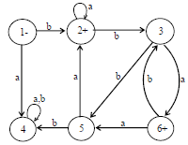
Remark: In the above theorem, it is not affected if the z-part has circuit. To prove the theorem it is only to find a circuit and then looping that circuit, is all that is needed. While looping the circuit the volume of the string y (or z) is pumped, so the theorem is also called the Pumping lemma.
Following are the examples :
Consider the following 5 states FA, say, F which accepts an infinite language

Slide 22
Let the word w = bbbababa, belonging to the language L, so that the length of word is greater than 6 (the number of states in F).
The word w, in this case, may be divided into three parts.
Thus the word w may be written as w = xyz, where x,y,z are strings belonging to A* and y cannot be null string.
The state 2 is such that it is revisited first while reading the word w. So the word w can be decomposed, according to pumping lemma, as w = xyz = (b)(bba)(baba)
If y-part of w is continuously pumped, the resulting strings will be accepted by F and hence will be words in the language accepted by F.
Thus, by pumping lemma, the language accepted by F is regular.

Slide 23
Example
Consider the language EQUAL, of strings, defined over ∑={a,b}, with number of a’s equal to number of b’s, i.e. EQUAL = {A ,ab,aabb,abab,baba,abba,…}
From the definition of EQUAL, it is clear that {a^{n} b^{n} } =
a* b* EQUAL
Obviously a* b* defines a regular language while {a^{n} b^{n} } has been proved nonregular.
Using the theorem that intersection of two regular languages is, regular; it can be proved that the EQUAL is not regular.
Because if it is considered regular then the language {a^{n} b^{n} } will, being intersection of regular languages, be regular language, which is impossible.
U

Slide 24
Following are the remarks regarding these examples
Remarks
In the previous examples, languages are proved to be regular or nonregular using pumping lemma. In fact to prove a certain language to be regular, it is not needed to use the full force of pumping lemma i.e. for a word with length greater than the number of states of the machine, decomposing the word into xyz and for a language to be regular it is sufficient that xyyz is in L. The condition that xy^{n}z is in L for n>2, provides that the language is infinite.
Consider the language PALINDROME and a word w = aba belonging to PALINDROME. Decomposing w = xyz where x=a, y=b, z=a. It can be observed that the strings of the form xy^{n}z for n=1,2,3, …, belong to PALINDROME. Which shows that the pumping lemma holds for the language PALINDROME (which is non regular language). To overcome this drawback of pumping lemma, a revised version of pumping lemma is to be introduced.

Slide 25
Pumping lemma version II, proof, examples, Myhill Nerode theorem, examples
Pumping Lemma version II
Statement
Let L be an infinite language accepted by a finite automaton with N states, then for all words w in L that have langth more than N, there are strings x,y and z (y being non-null string) and length(x) + length(y)  N s.t. w = xyz and all strings of the form xynz are in L for n = 1,2,3, …

Slide 26
Example
Consider the language PRIME, of strings defined over G = {a}, as {ap : p is prime}, i.e.
PRIME = {aa, aaa, aaaaa, aaaaaaa, …}
To prove this language to be nonregular, suppose contrary, i.e. PRIME is a regular language, then there exists an FA accepts the language PRIME. Let the number of states of this machine be 345 and choose a word w from PRIME with length more than 345, say, 347 i.e. the word w = a347
Since this language is supposed to be regular, therefore according to pumping lemma xynz, for n = 1,2,3,… are all in PRIME.
Consider n=348, then xynz = xy348z = xy347yz. Since x,y and z consist of a’s, so the order of x, y, z does not matter i.e. xy347yz = xyzy347 = a347 y347, y being non-null string and consisting of a’s it can be written y = am,m=1,2,3,…,345.
Thus xy348z = a347 (am)347 = a347(m+1)
Now the number 347(m+1) will not remain PRIME for m = 1,2,3, …, 345. Which shows that the string xy348z is not in PRIME. Hence pumping lemma version II is not satisfied by the language PRIME. Thus PRIME is not regular.

Slide 27
Strings belonging to same class
Consider a regular language L, defined over an alphabet A. If, two strings x and y, defined over A, are run over an FA accepting the language L, then x and y are said to belong to the same class if they end in the same state, no matter that state is final or not.

Slide 28
Myhill Nerode theorem
Statement
For a language L, defined over an alphabetA,
L partitions A* into distinct classes.
If L is regular then, L generates finite number of classes.
If L generates finite number of classes then L is regular.

Slide 29

Example
Consider the language L of strings, defined over ∑ = {a,b}, ending in a.
It can be observed that L partitions A* into the following two classes
C₁ = set of all strings ending in a.
C₂ = set of all strings not ending in a.
Since there are finite many classes generated by L, so L is regular and hence following is an FA, built with the help of C₁ and C₂, accepting L.

Slide 30
Examples of Myhill Nerode theorem, Quotient of a language, examples, Pseudo theorem: Quotient of a language is regular, prefixes of a language,
Example
Consider the language L which is EVEN-EVEN, defined over S = {a,b}. It can be observed that L partitions S* into the following four classes
C₁ = set of all strings with even number of a’s and odd number of b’s.
C₂ = set of all strings with odd number of a’s and odd number of b’s.
C₃ = set of all strings with odd number of a’s and even number of b’s.
C₄ = set of all strings with even number of a’s and even number of b’s.

Slide 31
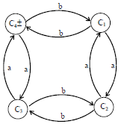

Slide 32
Example
Consider the language L = {w Є {a,b}*: length(w) 2, w ends in either ab or ba}. It can be observed that L partitions ∑* into the following seven classes
C₁ = set containing only null string.
C₂ = set containing only letter a.
C₃ = set containing only letter b.
C₄ = set of strings ending in aa.
C₅ = set of strings ending in ab.
C₆ = set of strings ending in ba.
C₇ = set of strings ending in bb.

Slide 33
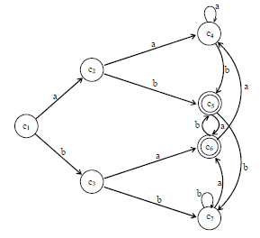
Since there are finite many classes generated by L, so L is regular and hence FA shown aside, is built with the help of C₁, C₂, C₃ , C₄, C₅ , C₆ and C₇, accepting L

Slide 34
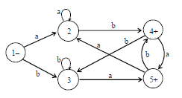
Following is an FA equivalent to the above FA

Slide 35
Quotient of a language into another
Remark The theorem has been proved to show under what conditions a language is regular. It has also been proved that the product of two regular languages is regular.
The question arises that whether there exists a theorem showing that quotient of regular languages is regular.
There is a problem in defining the quotient of two regular languages. There is an approach in defining the quotient of regular languages i.e. the language Q is said to be quotient of two regular languages P and R, denoted by Q=R/P if PQ=R.
It is to be noted that this definition does not determine a unique language e.g. for P=Q=R expressed by a* then PQ=R and so Q=R/P i.e. a*=a* / a*. But for Q={Λ}, P=R expressed by a*, PQ=R is still true which shows that Q={Λ}=R/P expressed by a* / a*

Slide 36
Pseudo theorem
Statement
For three languages P,Q and R, while PQ=R the language Q must be regular if both P and R are regular.
(Note: It is to be noted that since this theorem is not true, so the theorem is called pseudo theorem.)
Disproof
The theorem can be disproved by contradiction i.e. supposing that Q is regular.
Let P=a*, Q be the product of {a^{n}b^{n}:n=0,1,2,…} and b* then PQ=a*{a^{n}b^{n}}b*=a*b*=R which shows that R is regular.

Slide 37
To disproof this theorem, it is sufficient to prove that Q is not regualr. By definition, the words in Q are of the form a^{x}b^{y} where x ≤ y. Let Q be regular and hence there exists an FA that accepts Q. Suppose the number of states in this machine be N.
Now the word a^{N}b^{N} is also in Q and must be accepted by this FA.
Since the number of states in this machine is N, there must be a circuit in this machine to run the substring a^{N}.
Thus while accepting the word a^{N}b^{N}, the machine looping the circuit once again, can accept the word a^{more than N}b^{N}, which is not in Q. Hence it is impossible to find any FA that accepts exactly the language Q.
Thus Q is not regular and hence the theorem is disproved.

Slide 38
Prefixes of a language in another language
If two languages R and Q are given, then the language the prefixes of Q in R denoted by Pref(Q in R) is the set of strings of letters that, when concatenated to the front of some word in Q to produce some word in R i.e.
Pref(Q in R) = the set of all strings p such that there exists words q in Q and w in R such that pq = w.
Following are the examples
Example
Let Q = {aa,abaaabb,bbaaaaa,bbbbbbbbbb} and R = {b,bbbb,bbbaaa,bbbaaaaa}
It can be observed that aa and bbaaaaa occur at the ending parts of some words of R, hence these words help in defining the language pref(Q in R). Thus pref(Q in R) = {b,bbba,bbbaaa}

Slide 39
LINK
www.cs.odu.edu/~toida/nerzic/390teched/regular/reg-lang/non-regularity.html
www.tf.uni-kiel.de/matwis/amat/def_en/kap_2/basics/m2_1_1.html

